Slide 1
CAPSTONE PROJECT: CAR SALES ANALYSIS
BY NaNDINI DUTTA

Slide 2
Introduction
Background :
Our company is a car dealership that sells various car models. To effectively track and analyse our sales performance, we need a comprehensive Car Sales Dashboard in Power BI.
Objective :
The objective of this project is to design and develop a dynamic and interactive Car Sales Dashboard using Power BI. The dashboard will visualize critical KPIs related to our car sales, helping us to understand our sales performance over time and make data-driven decisions.

Slide 3
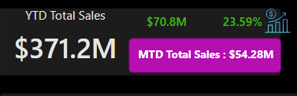
PROBLEM STATEMENT : KPI’s REQUIREMENT
The dashboard should provide real-time insights into key performance indicators (KPIs) related to our sales data. This will enable us to make informed decisions, monitor our progress, and identify trends and opportunities for growth.
Sales Overview:
Year-to-Date (YTD) Total Sales
Month-to-Date (MTD) Total Sales
Year-over-Year (YOY) Growth in Total Sales
Difference between YTD Sales and Previous Year-to-Date (PTYD) Sales

Slide 4
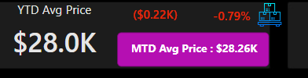
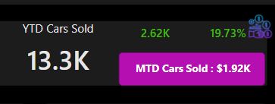
Average Price Analysis:
YTD Average Price
MTD Average Price
YOY Growth in Average Price
Difference between YTD Average Price and PTYD Average Price
Cars Sold Metrics:
YTD Cars Sold
MTD Cars Sold
YOY Growth in Cars Sold
Difference between YTD Cars Sold and PTYD Cars Sold

Slide 5
CHARTS REQUIREMENT
YTD Sales Weekly Trend
YTD Total Sales by Body Style
YTD Total Sales by Colour
YTD Cars Sold by Dealer Region
Company-Wise Sales Trend in Grid Form
Details Grid Showing All Car Sales Information

Slide 6
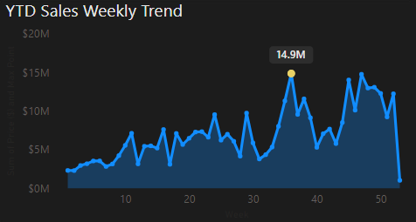
CHARTS OF DASHBOARD 1
YTD Sales Weekly Trend: Display a line chart illustrating the weekly trend of YTD sales. The X-axis should represent weeks, and the Y-axis should show the total sales amount.
Key Finding:
It is showing an irregular nature of time series data for most of the cases, which is very unpredictable. If there is no trend or seasonality, the sales prediction becomes less accurate.

Slide 7
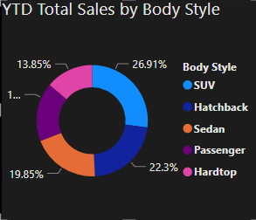
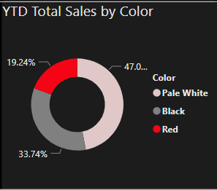
YTD Total Sales by Body Style: Visualize the distribution of YTD total sales across different car body styles using a Donut chart.
YTD Total Sales by Colour: Present the contribution of various car colours to the YTD total sales through a Donut chart.
Key Finding:
If a company wants to generate revenue fast, it may focus on the combination of SUV & Hatchback with Pale White & Black colour. If a company's sales performance is not up to the mark, then it may not focus on the Red Hardtop products. So, for manufacturing a product, a company must focus on the combination of Style & Colour simultaneously.

Slide 8
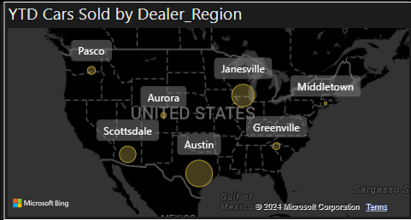
YTD Cars Sold by Dealer Region: Showcase the YTD sales data based on different dealer regions using a map chart to visualize the sales distribution geographically.
Key Finding:
Here, the size of the bubbles are indicating the amount of sales. A company must focus on those particular regions where the sales are very low. It may go for a market survey, collect customer feedback and analyze the reasons for low sales. May be there is a need for training for sales persons or the showrooms may increase variety in there stock etc.

Slide 9
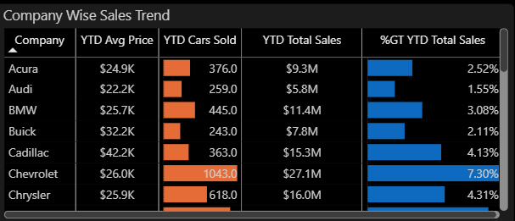
Company-Wise Sales Trend in Grid Form: Provide a tabular grid that displays the sales trend for each company. The grid should showcase the company name along with their YTD sales figures.
Key Finding:
It is a summarized overview of all the companies where we can easily notice the four important measures at a glance and compare the measures of one company with the others.

Slide 10
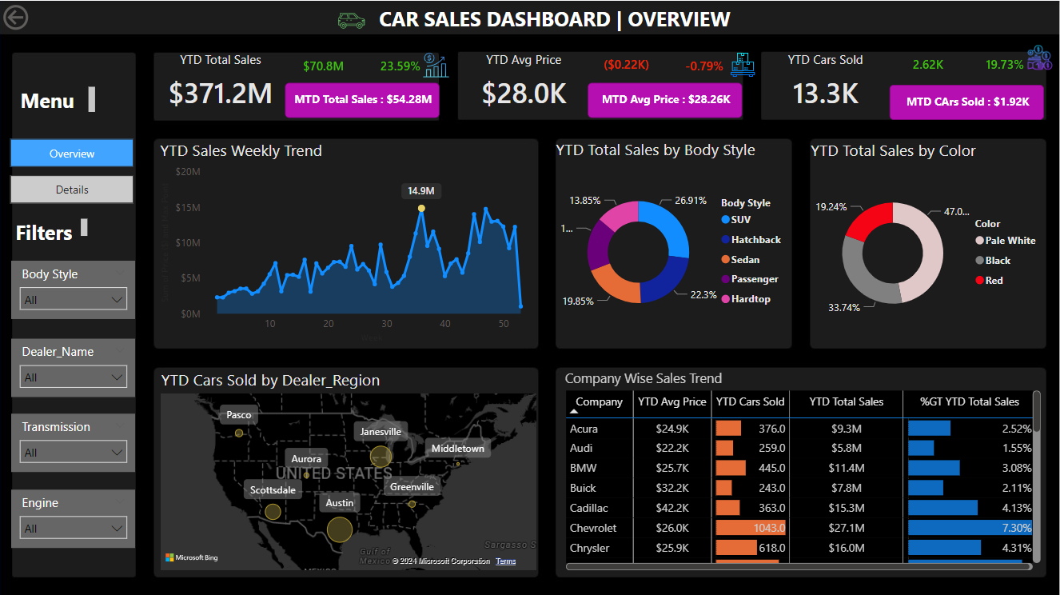
DASHBOARD 1

Slide 11
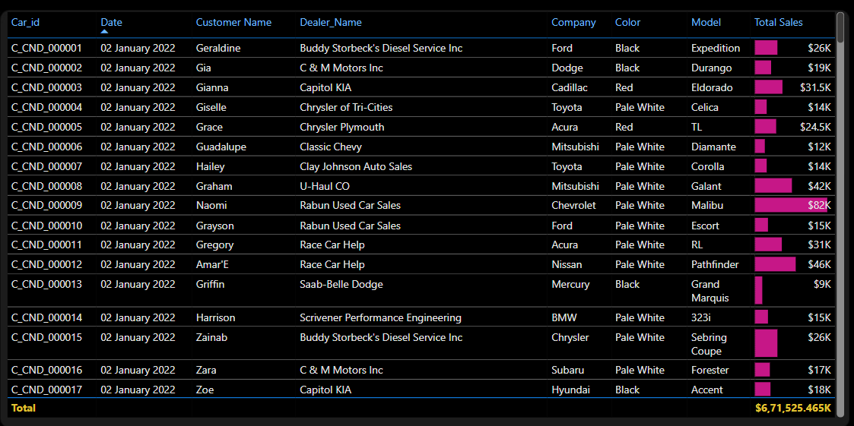
CHART OF DASHBOARD 2
Details Grid Showing All Car Sales Information: Create a detailed grid that presents all relevant information for each car sale, including Car_id, Date, Customer Name, Dealer_Name, Company, Colour, Model.
Key Finding:
It is a row by row details of the whole sales data, where each row is having all the information of a particular car sold. Here end users can filter the table multiple times for multiple fields according to their need.

Slide 12
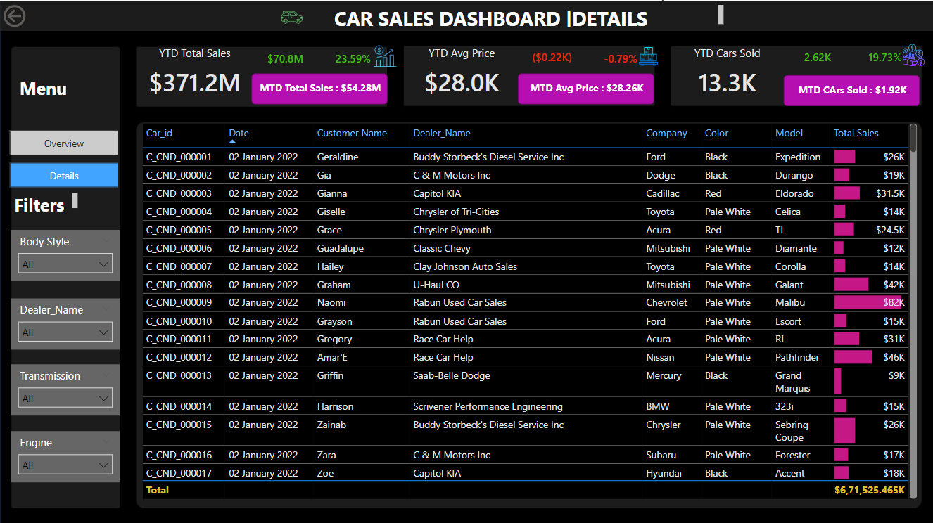
DASHBOARD 2

Slide 13
CONCLUSION
The car sales analysis provides valuable insights into the automotive market, highlighting key trends, consumer preferences, and competitive dynamics. By leveraging these insights, stakeholders can make informed decisions, develop targeted strategies, and drive growth in the rapidly evolving automotive industry.

